Slide 1

Fundación Mapfre in the United States
Notes:
PARA AÑADIR el extra de IMAGEN DE FONDO: Diseño > Formato de fondo > Selecciona “Imagen o textura”

Slide 2
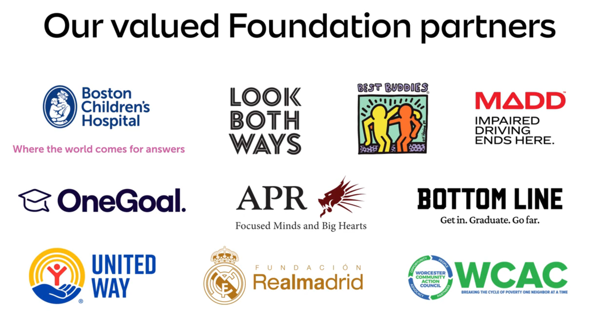
Fundación Mapfre in the United States
In 2026, Fundación Mapfre is providing $1.3 million to 10 local partner organizations.

Slide 3


Fundación Mapfre in the United States
Hear what some of our partners are saying:

Slide 4
Fundación Mapfre in the United States
By the Numbers
Social Action | FM Partner Since | Direct Beneficiaries
Academy of the Pacific Rim Charter School | 2023 | 545
Best Buddies Massachusetts | 2019 | 216
Bottom Line | 2019 | 1,511
OneGoal | 2021 | 1,512
The Real Madrid Fundacion Sports Program | 2019 | 80
United Way South Central Massachusetts | 2009 | 1,999
Total Social Action Beneficiaries |  | 5,863
Injury Prevention & Road Safety | FM Partner Since | Direct Beneficiaries
Boston Children’s Hospital | 2017 | 53,974
Look Both Ways | 2019
Mothers Against Drunk Driving | 2019
UMass Memorial Medical Center | 2023 | 1,999
Total Injury Prevention & Road Safety Beneficiaries |  | 55,973

Slide 5
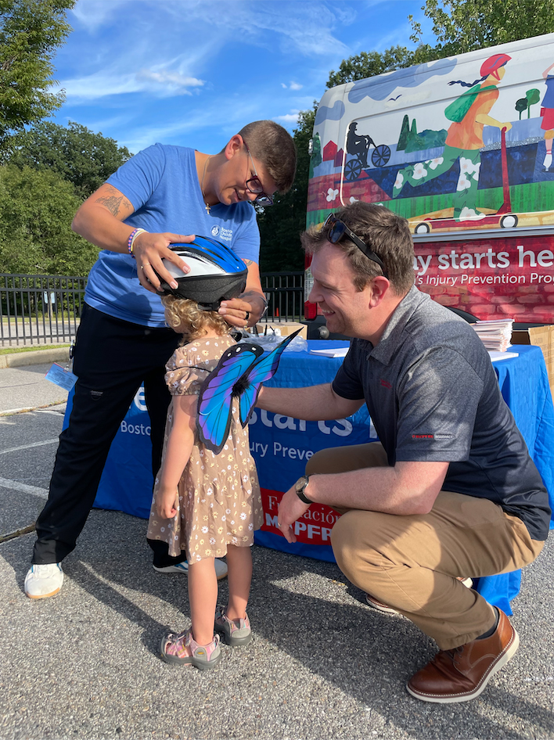

Fundación Mapfre in the United States
Injury Prevention and Road Safety
Injury Prevention Program: Safe Play Starts Here.
Goal is to reduce and prevent the number and severity of injuries endured by children and adolescents in Boston and its nearby communities through education, advocacy and research.
Child Passenger Safety Nurse Champion Course: Spanish translation
Car Seat and Child Passenger Safety Program: Providing funding for 560 car seats and 360 helmets
Community Education Needs: ThinkFirst and Stop The Bleed programs
New spine and brain models
Stop The Bleed equipment, including 125 Stop The Bleed kits
300 tourniquets for community centers, schools, and partner organizations

Slide 6

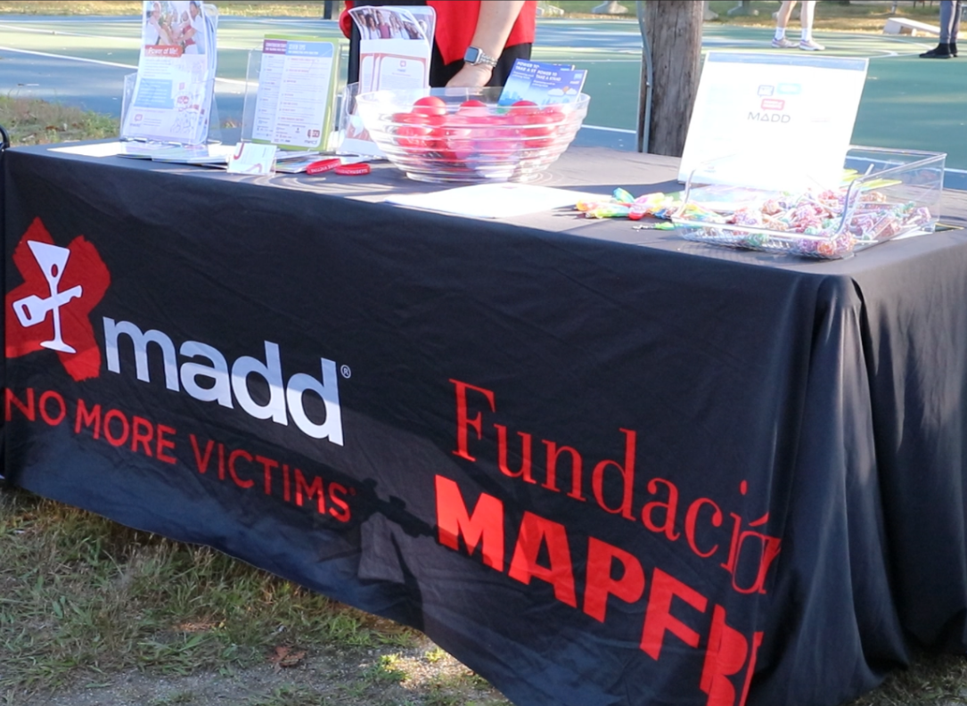
Fundación Mapfre in the United States
Injury Prevention and Road Safety
Power of Me Elementary Program (500 students): Classroom-based alcohol use prevention and vehicle safety presentation for elementary students grades 4 – 5
Promposal Program (1,500 students): Prom is a formal dance that is held towards the end of the school year for junior and senior high school students. Classroom presentation with students regarding underage drinking, cannabis, medication use and impaired driving.
Madd Spirt Program (1,500 students): Homecoming is a weekend-long back to school celebration for the entire high school with events inside and outside of the school. Educates on risks associated with underage substance use and impaired driving and encouraging traffic safety.

Slide 7
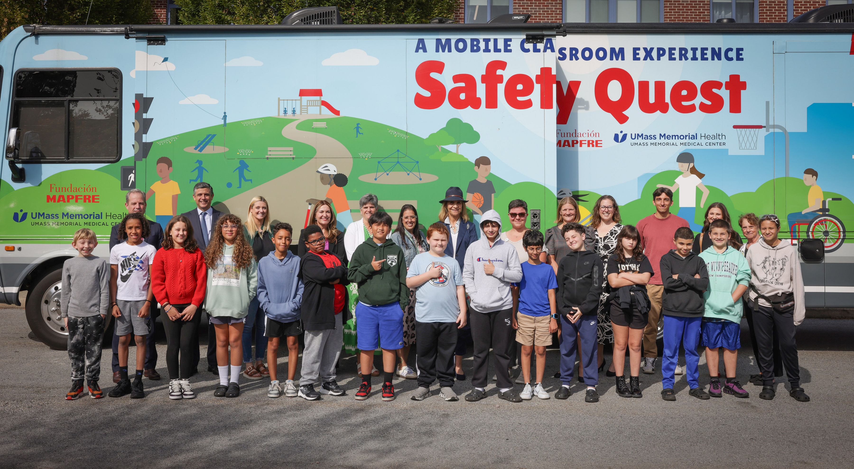

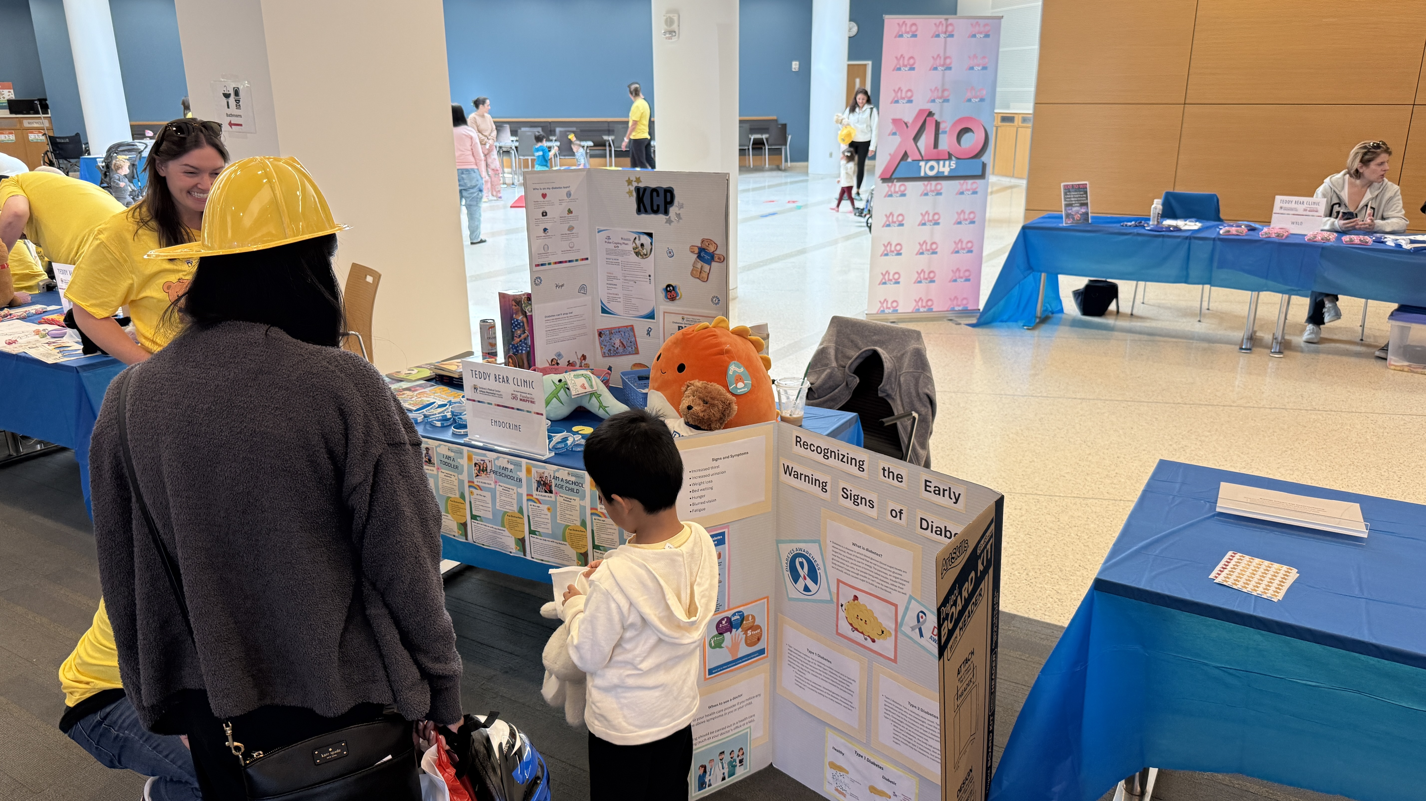
Fundación Mapfre in the United States
Injury Prevention and Road Safety
SafetyQuest Mobile Classroom: Interactive and engaging learning experience about safety and injury prevention for fifth grade students and wider community focusing on homes, schools and neighborhoods across the region.
Teddy Bear Clinic (500 attendees in 2025): Interactive stations that present topics in child-friendly ways to teach about health, safety and what to expect when they go for medical care.
Car Seat Safety and Helmets: Helmets and related educational materials provided to patients at the hospital and over 200 community events.
Car Seat Safety program provides education to parents and the community with car seat distribution to Neonatal Intensive care Unite and Children’s Medical Center.

Slide 8


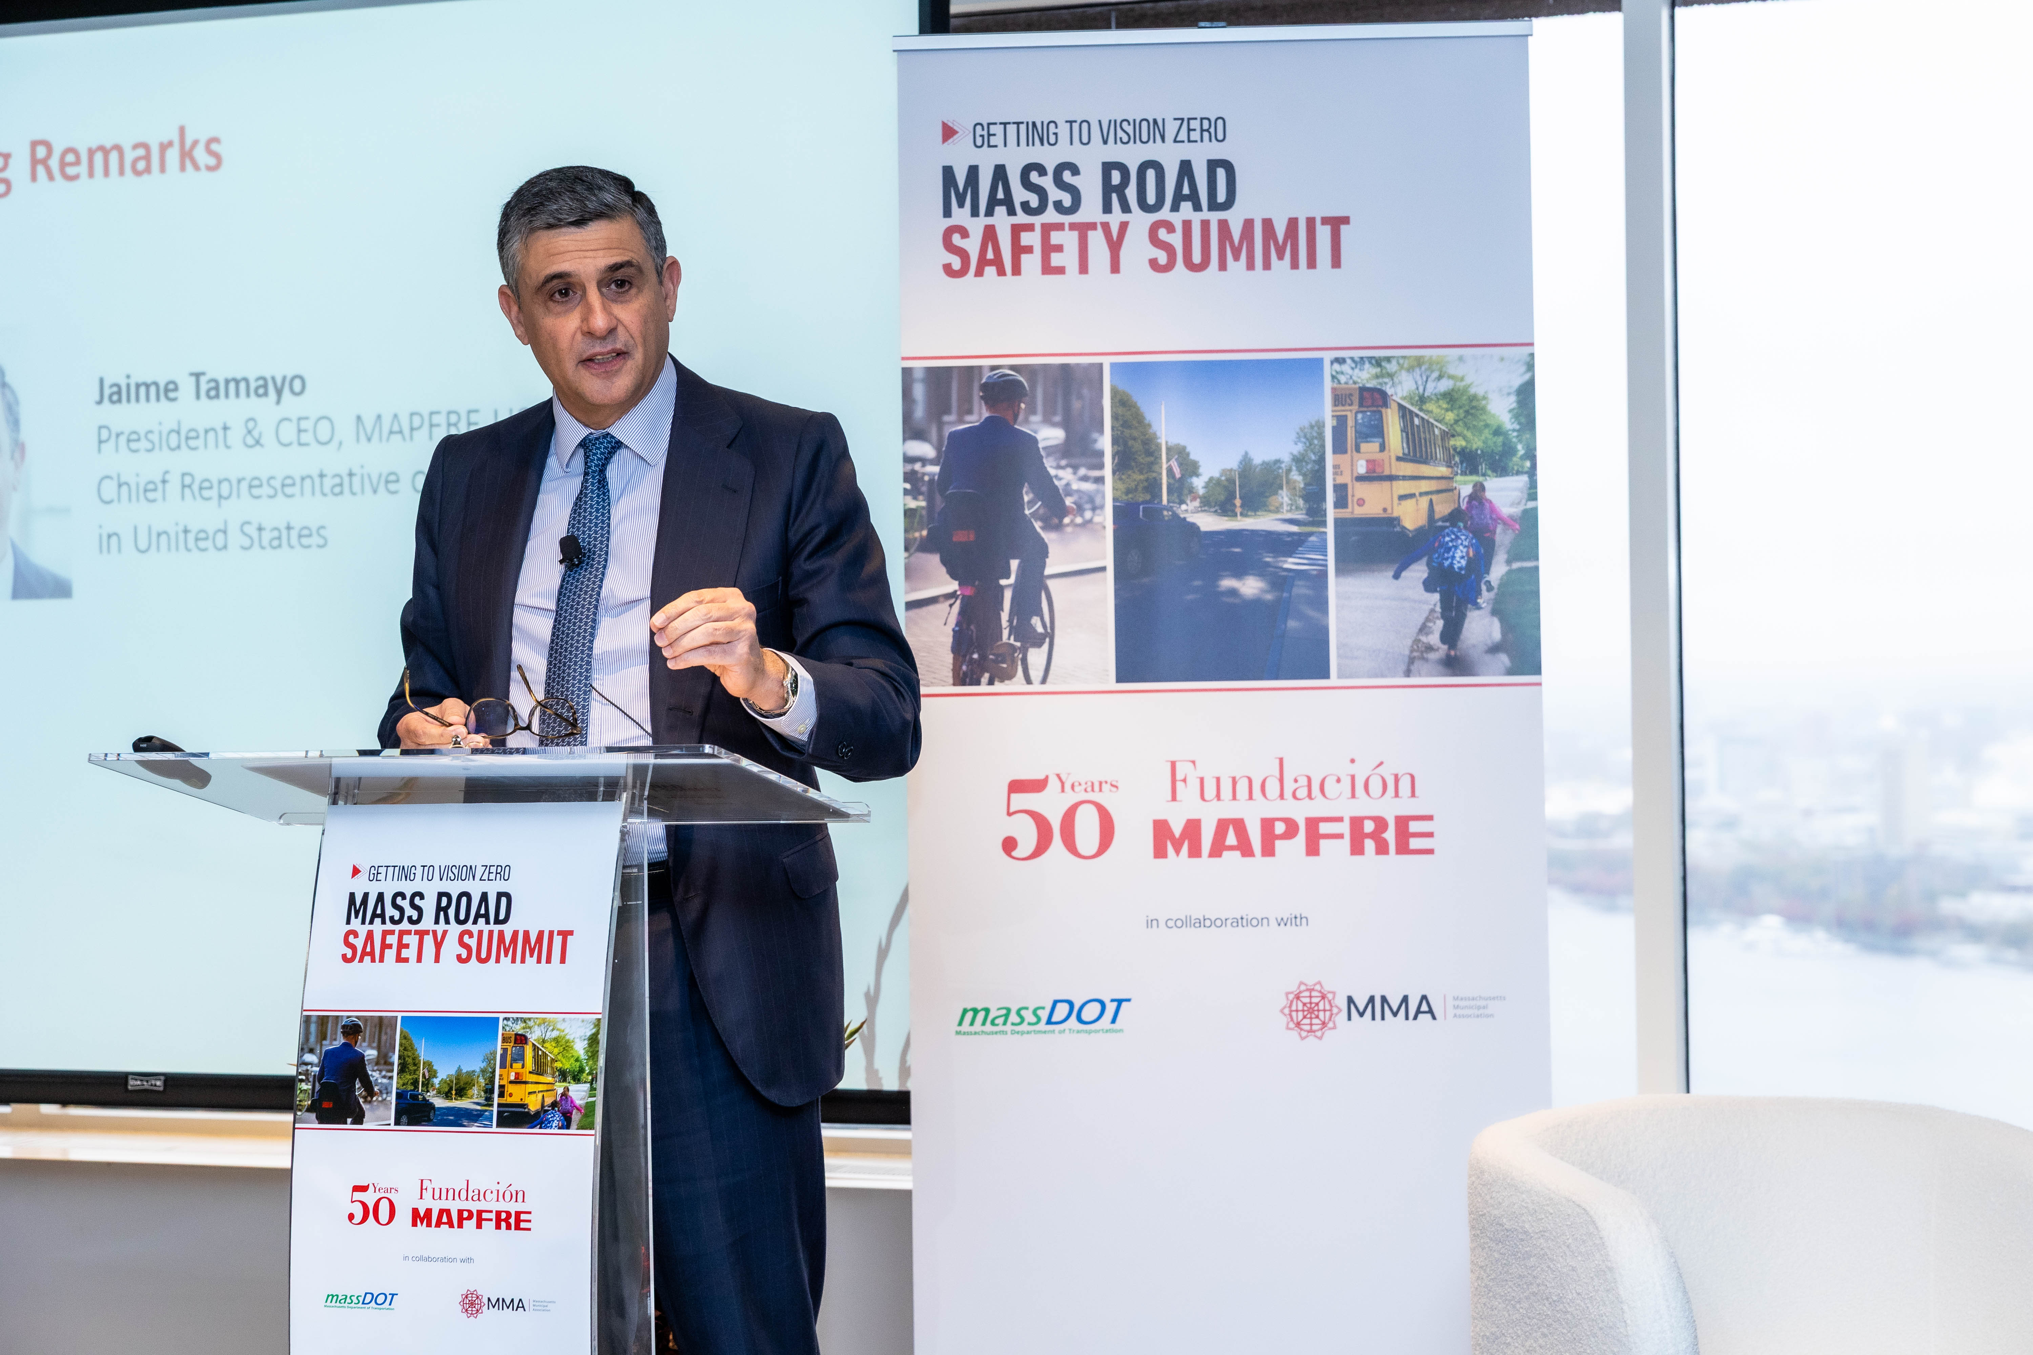
Fundación Mapfre in the United States
Injury Prevention and Road Safety
2025 winning script: “Art Heist” from Bishop Feehan High School
Look Both Ways High School PSA Contest: 2026 marks the 4th annual contest, which invites students to write a script for a TV spot that promotes safe driving. The winning team works with a Boston advertising agency to produce a professional, broadcast-ready PSA.
Road Safety Summit 2026: The 2026 summit will focus on teen road safety, bringing Mass. high school students together to elevate awareness of teen road safety and activate them as peer advocates within their schools.
Link: Getting to Vision Zero: Massachusetts Road Safety Summit Report
Jaime Tamayo speaking at 2025 Road Safety Summit

Slide 9
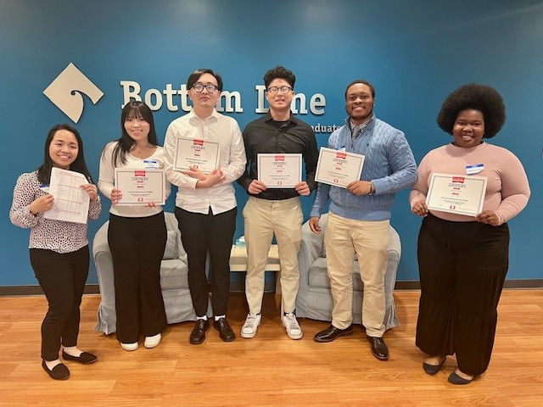

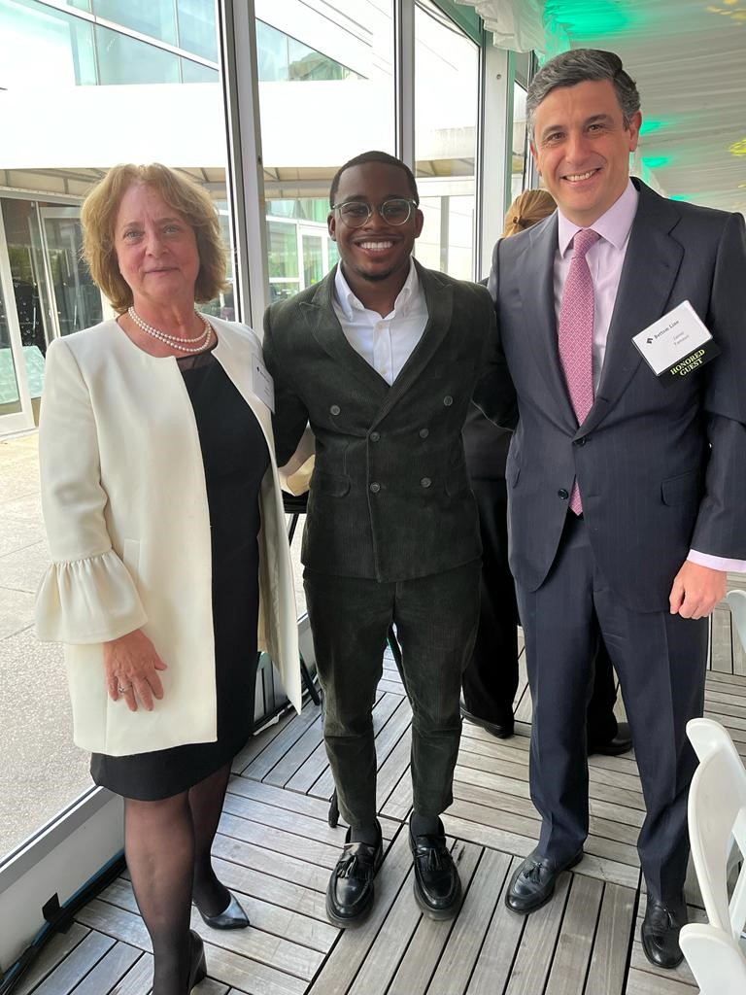
Fundación Mapfre in the United States
Social Action
College Access and College Success Program: Bottom Line’s Access and Success Program offers coaching and career guidance to more than 1,800 Massachusetts college students, partnering with 18 Massachusetts target colleges and universities.
Young Men of Color (YMOC) Program
Young Men of Color (YMOC) initiative designed to create greater educational equity and workforce inclusion by increasing the number of young men of color they serve, while also growing their overall college-to-career program.

Slide 10
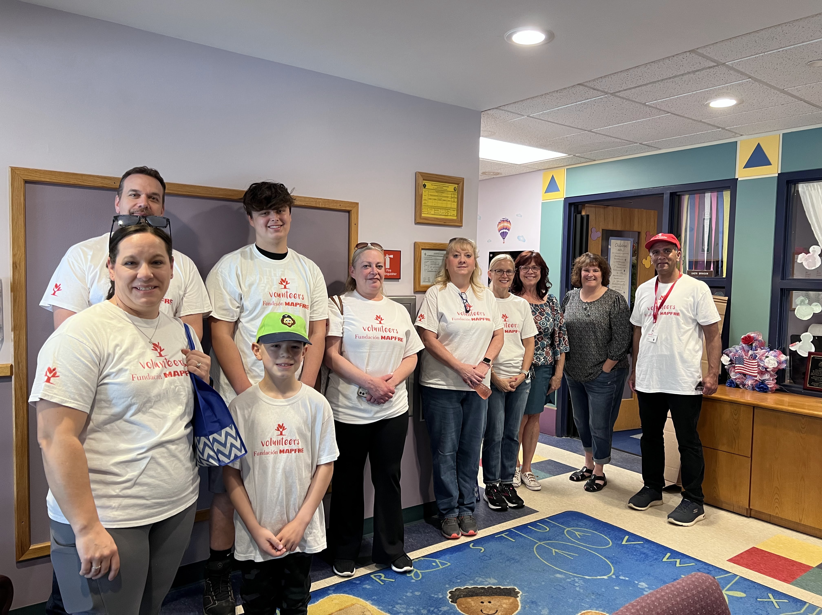
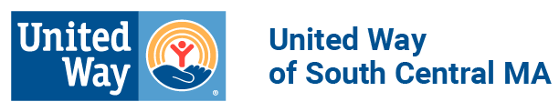
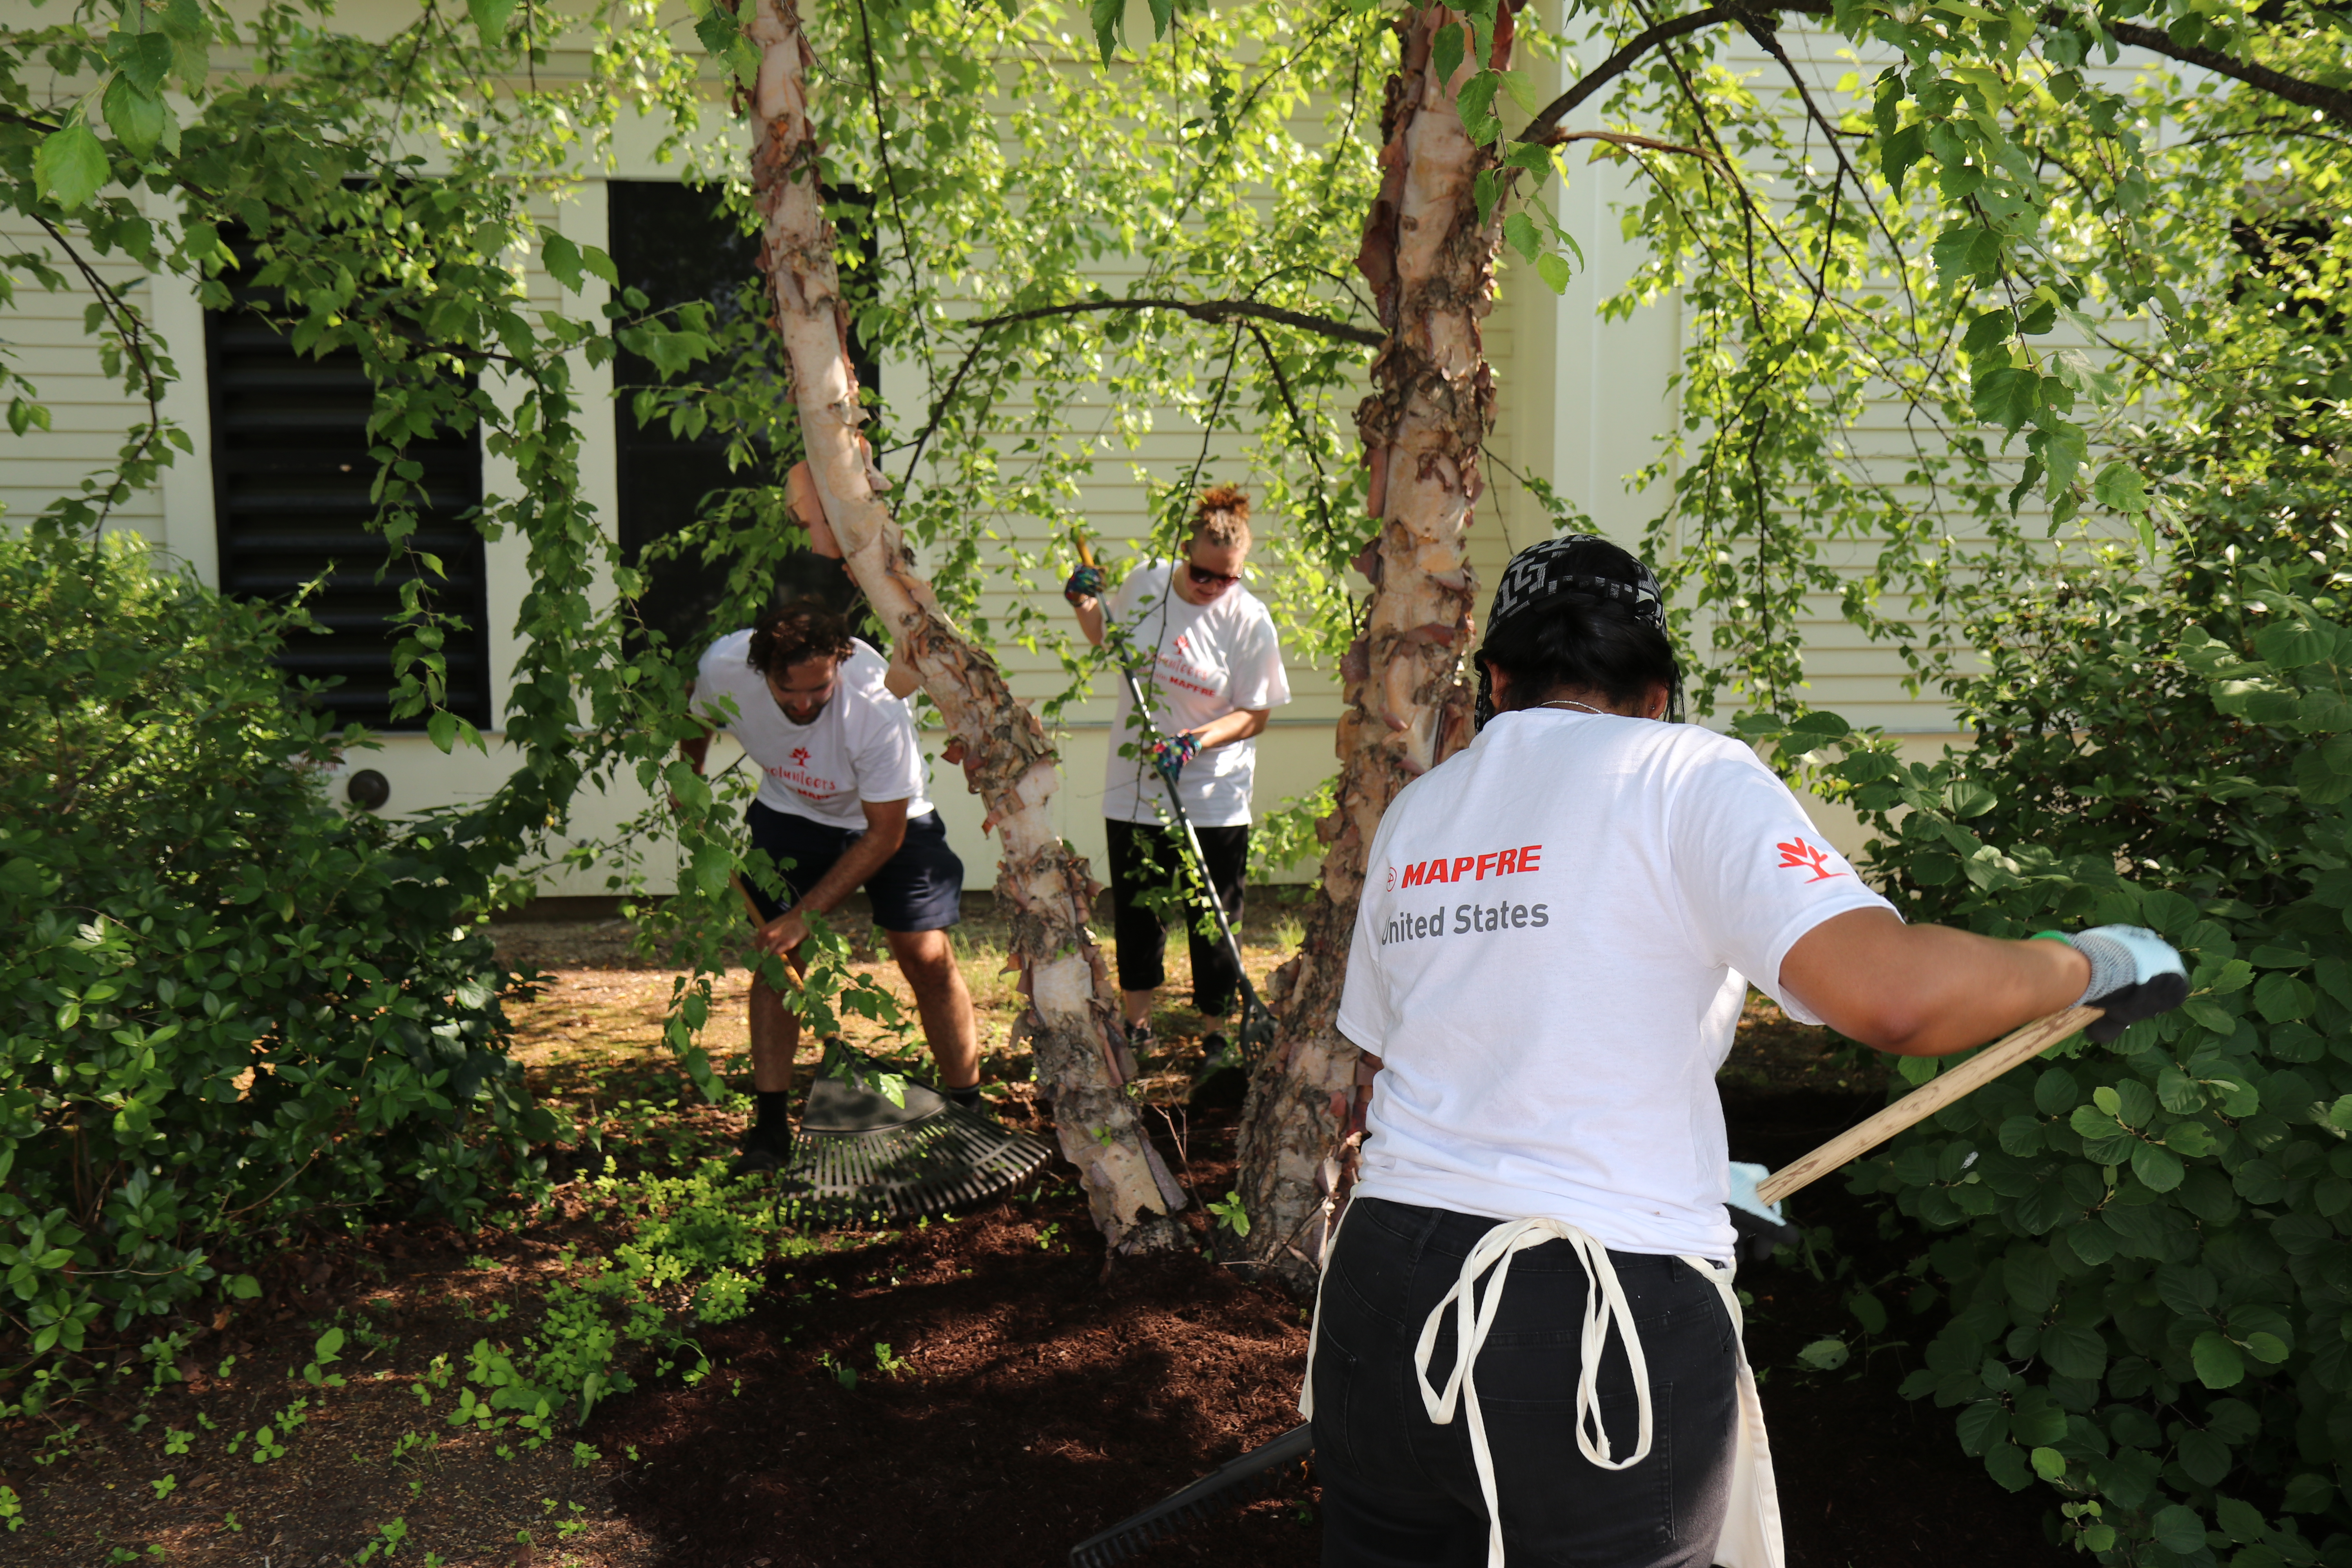
Fundación Mapfre in the United States
Social Action
United Way of South Central Massachusetts is a volunteer-driven organization that supports local agencies that provide health, education and financial stability services that profoundly affect the lives of those who live and work in the communities we serve.
Partnership includes Tri-Valley, Boys & Girls Club of Webster-Dudley and YMCA of Central Massachusetts.

Slide 11
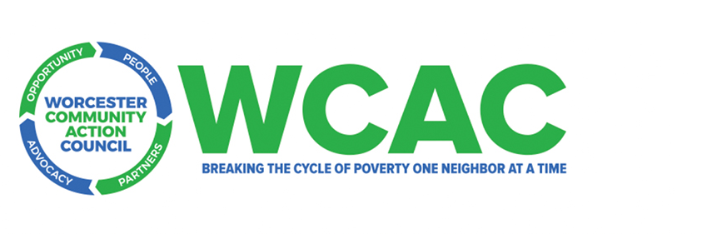
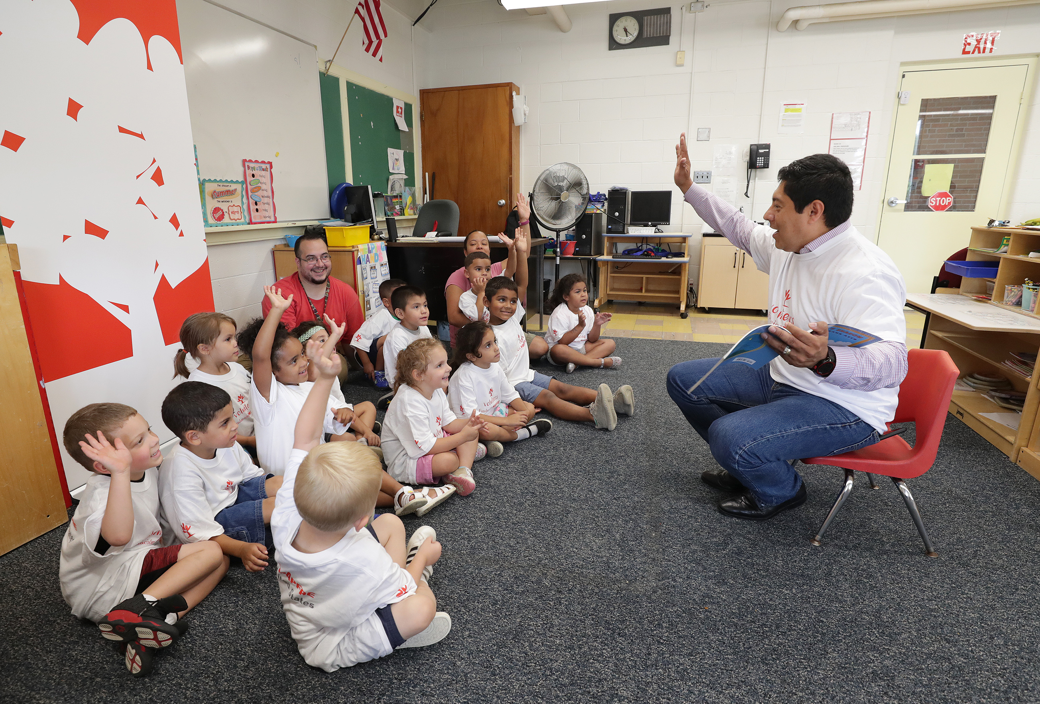
Fundación Mapfre in the United States
Social Action
WCAC’s Head Start program seeks to ensure the healthy development and proper growth of these children living in vulnerable situations.
Nutritional Program: Program provides students with nutritious meals throughout the day and promote health eating at home. Students are serviced nutritious breakfast, lunch and snack.
Science, Technology, Engineering, Arts, and Mathematics (STEAM) Program: Education and early learning for students integrating STEAM into everyday lessons.

Slide 12
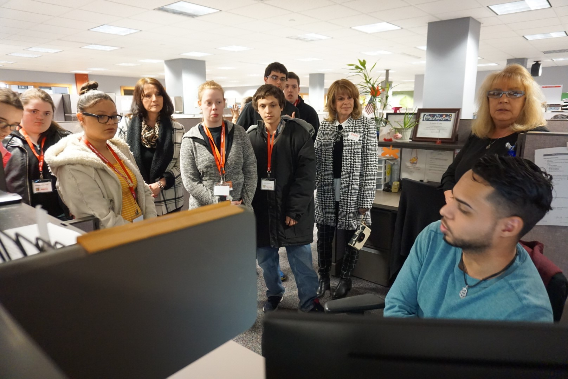

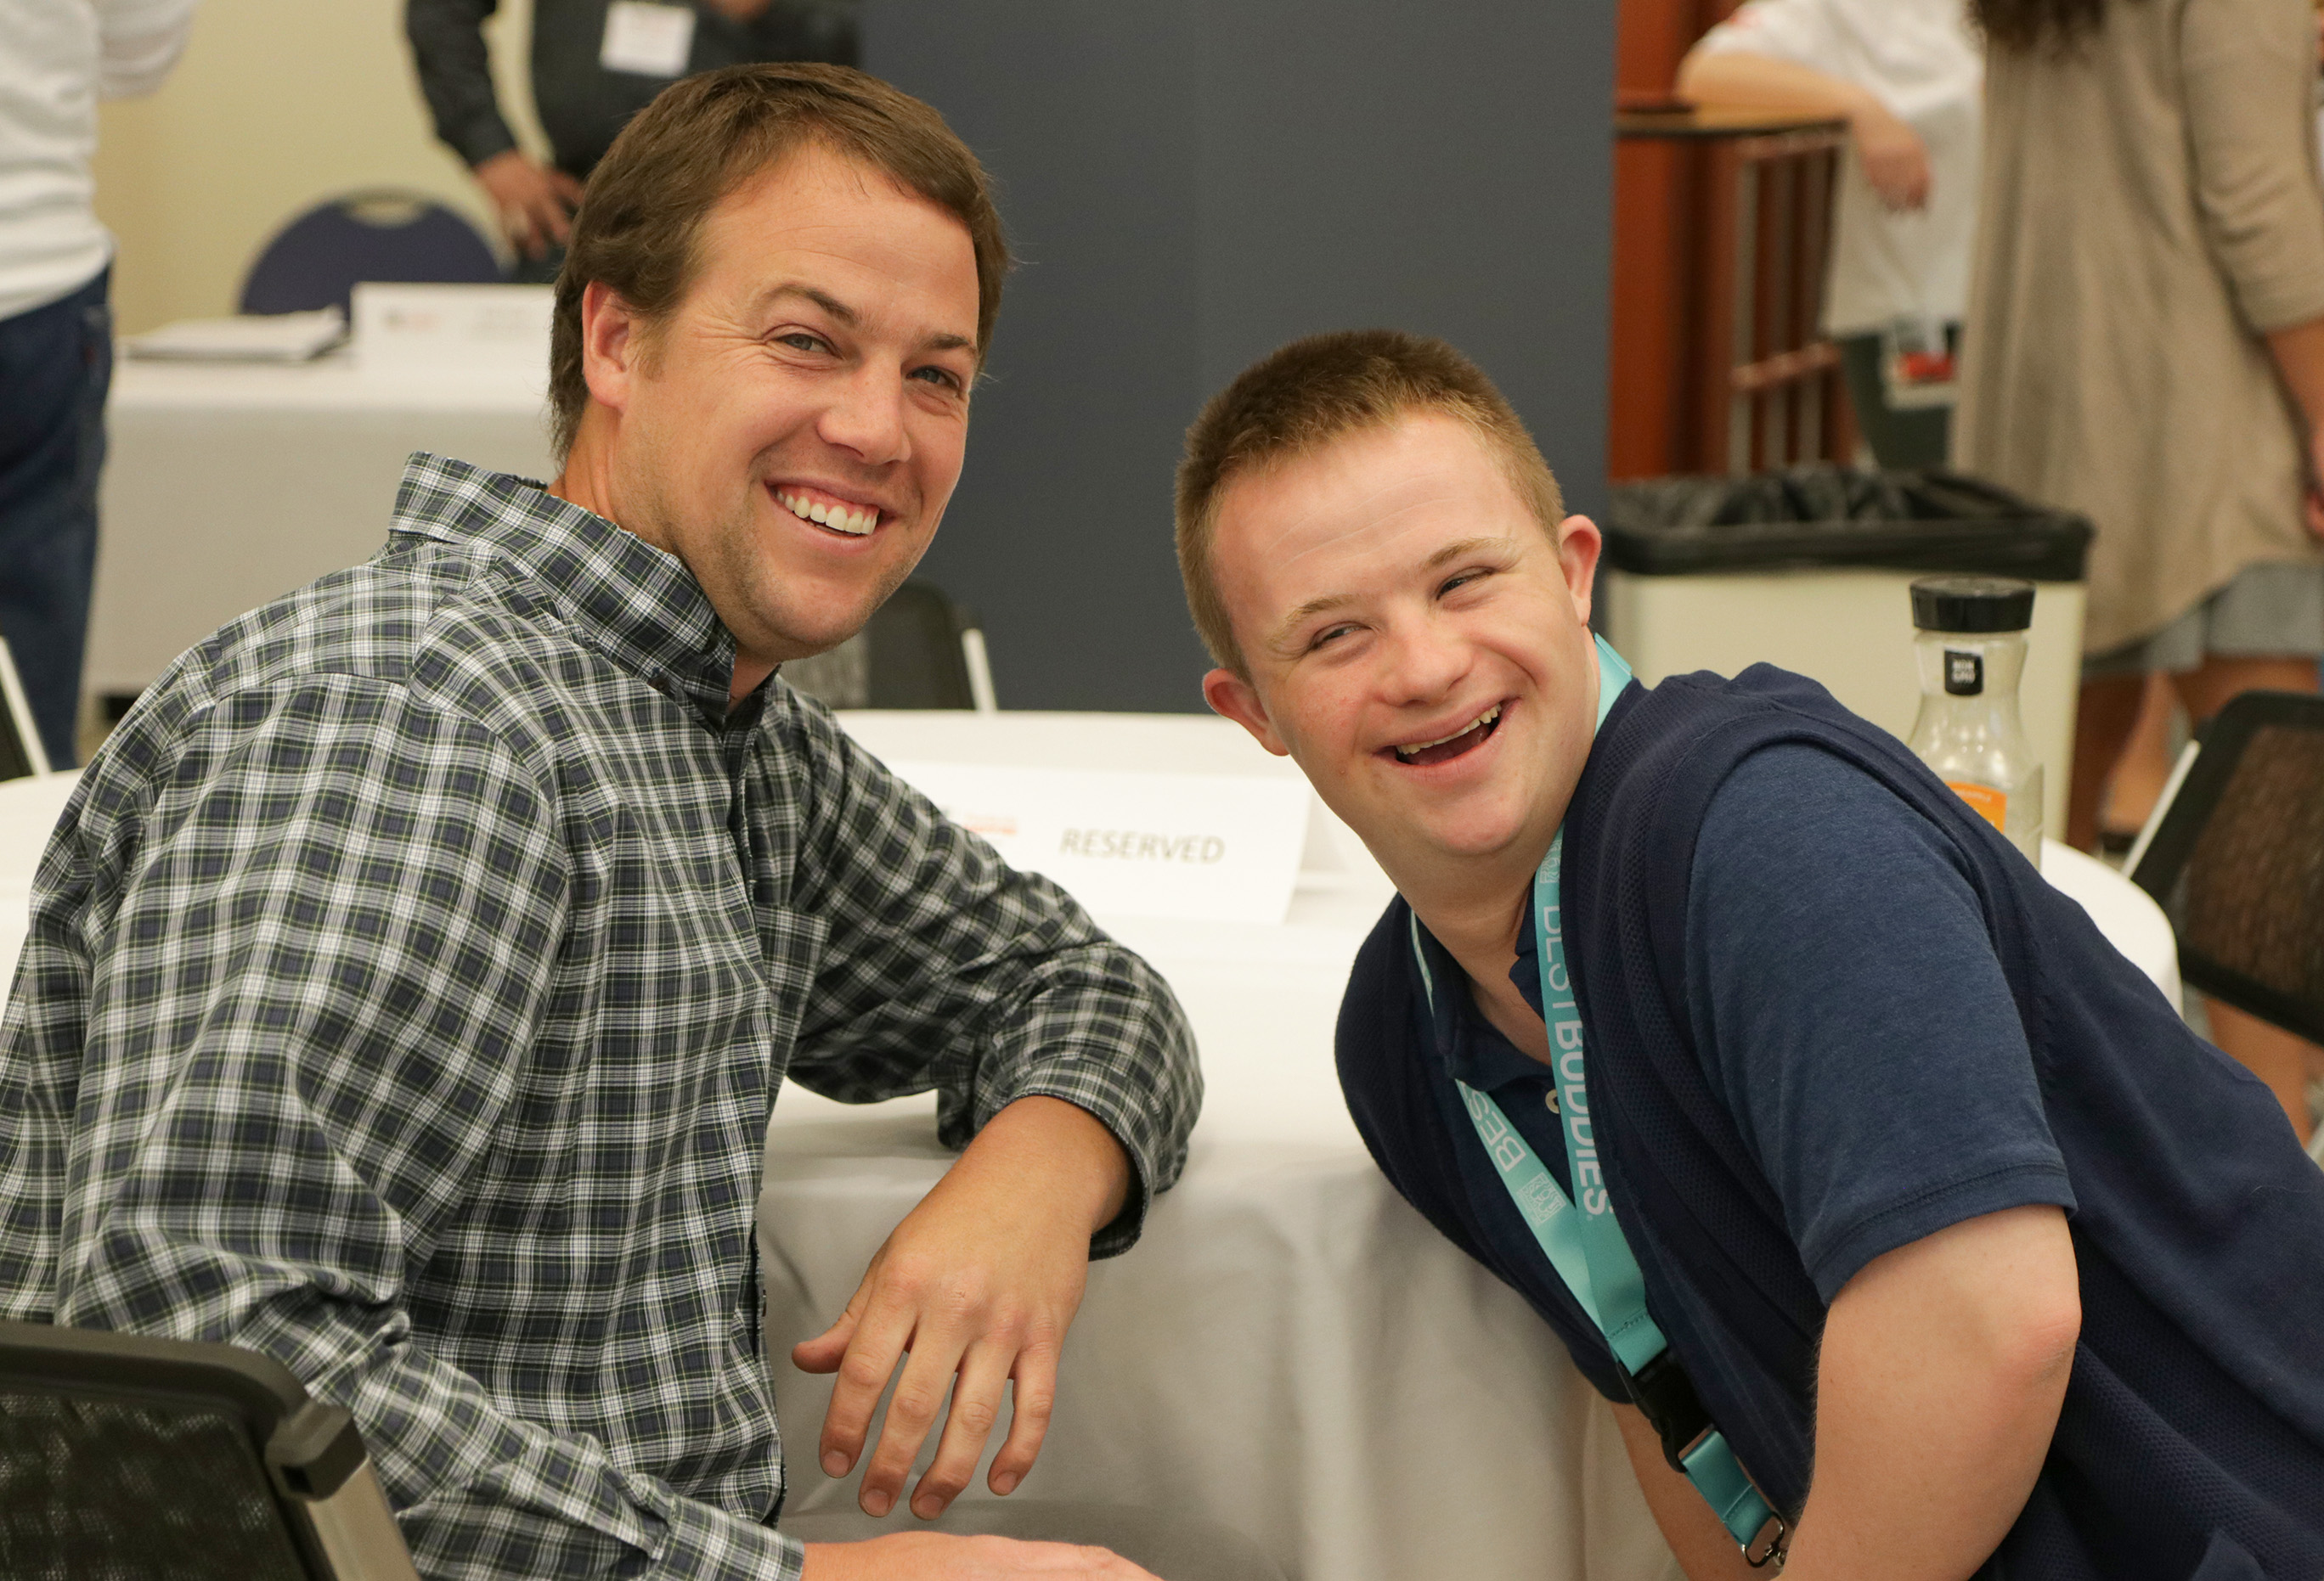
Fundación Mapfre in the United States
Social Action
Pre-Employment Training Program: Since its founding, the program has engaged 28 school districts, approximately 1,382 students, and more than 20 potentially hiring companies in Massachusetts alone.
The program model has been implemented in 20 U.S. states and has expanded internationally to Ireland, the Philippines, and Turkey.
As of December 2025, 4,800 students have engaged in 11,545 career readiness workshops with Best Buddies International across the globe.

Slide 13
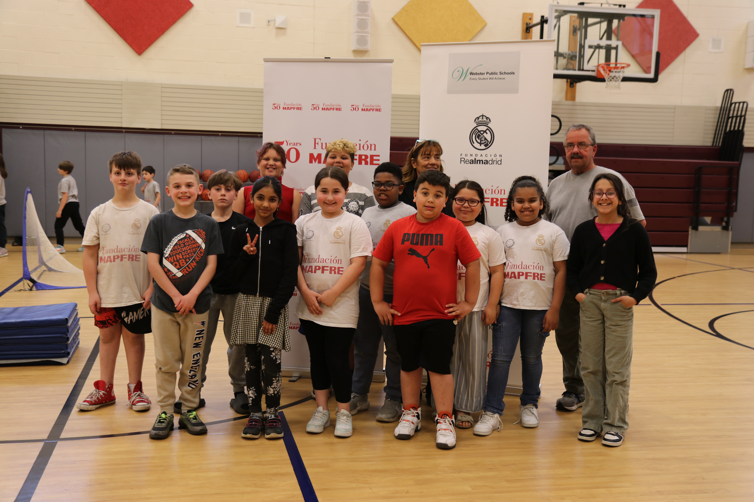

Fundación Mapfre in the United States
Social Action
The Real Madrid Foundation seeks to build enthusiasm and passion for sports among all children and youth around the world, providing social sports programs at schools for children ages 6 – 17.
The Real Madrid Fundación Youth Sports Program:
Fundación Mapfre partnered with the Real Madrid Foundation to bring their Youth Social Sports program to Webster Middle School in Massachusetts. This sports program fosters physical, intellectual, emotional and social development for mainly underserved children and youth and is a means of social inclusion.

Slide 14

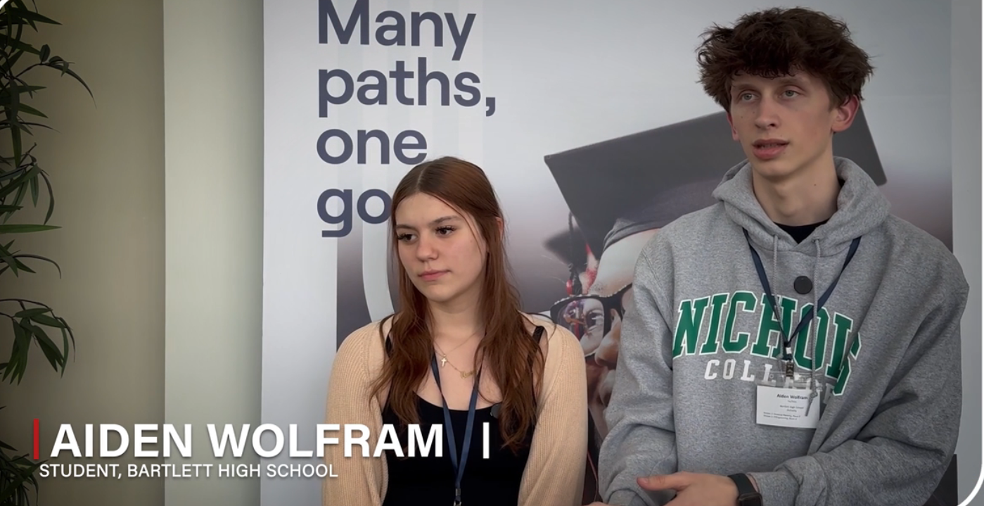
Fundación Mapfre in the United States
Social Action
OneGoal works with schools and districts to transform postsecondary support through their classroom-based model and OneGoal Leadership Network so that all students can define their futures.
OneGoal High School Classroom Cohorts:
Fundación Mapfre partners with OneGoal to support the cohorts of juniors, seniors and students in their first year of postsecondary education from Bartlett High School, Webster and Southbridge High School, Southbridge, Massachusetts.

Slide 15
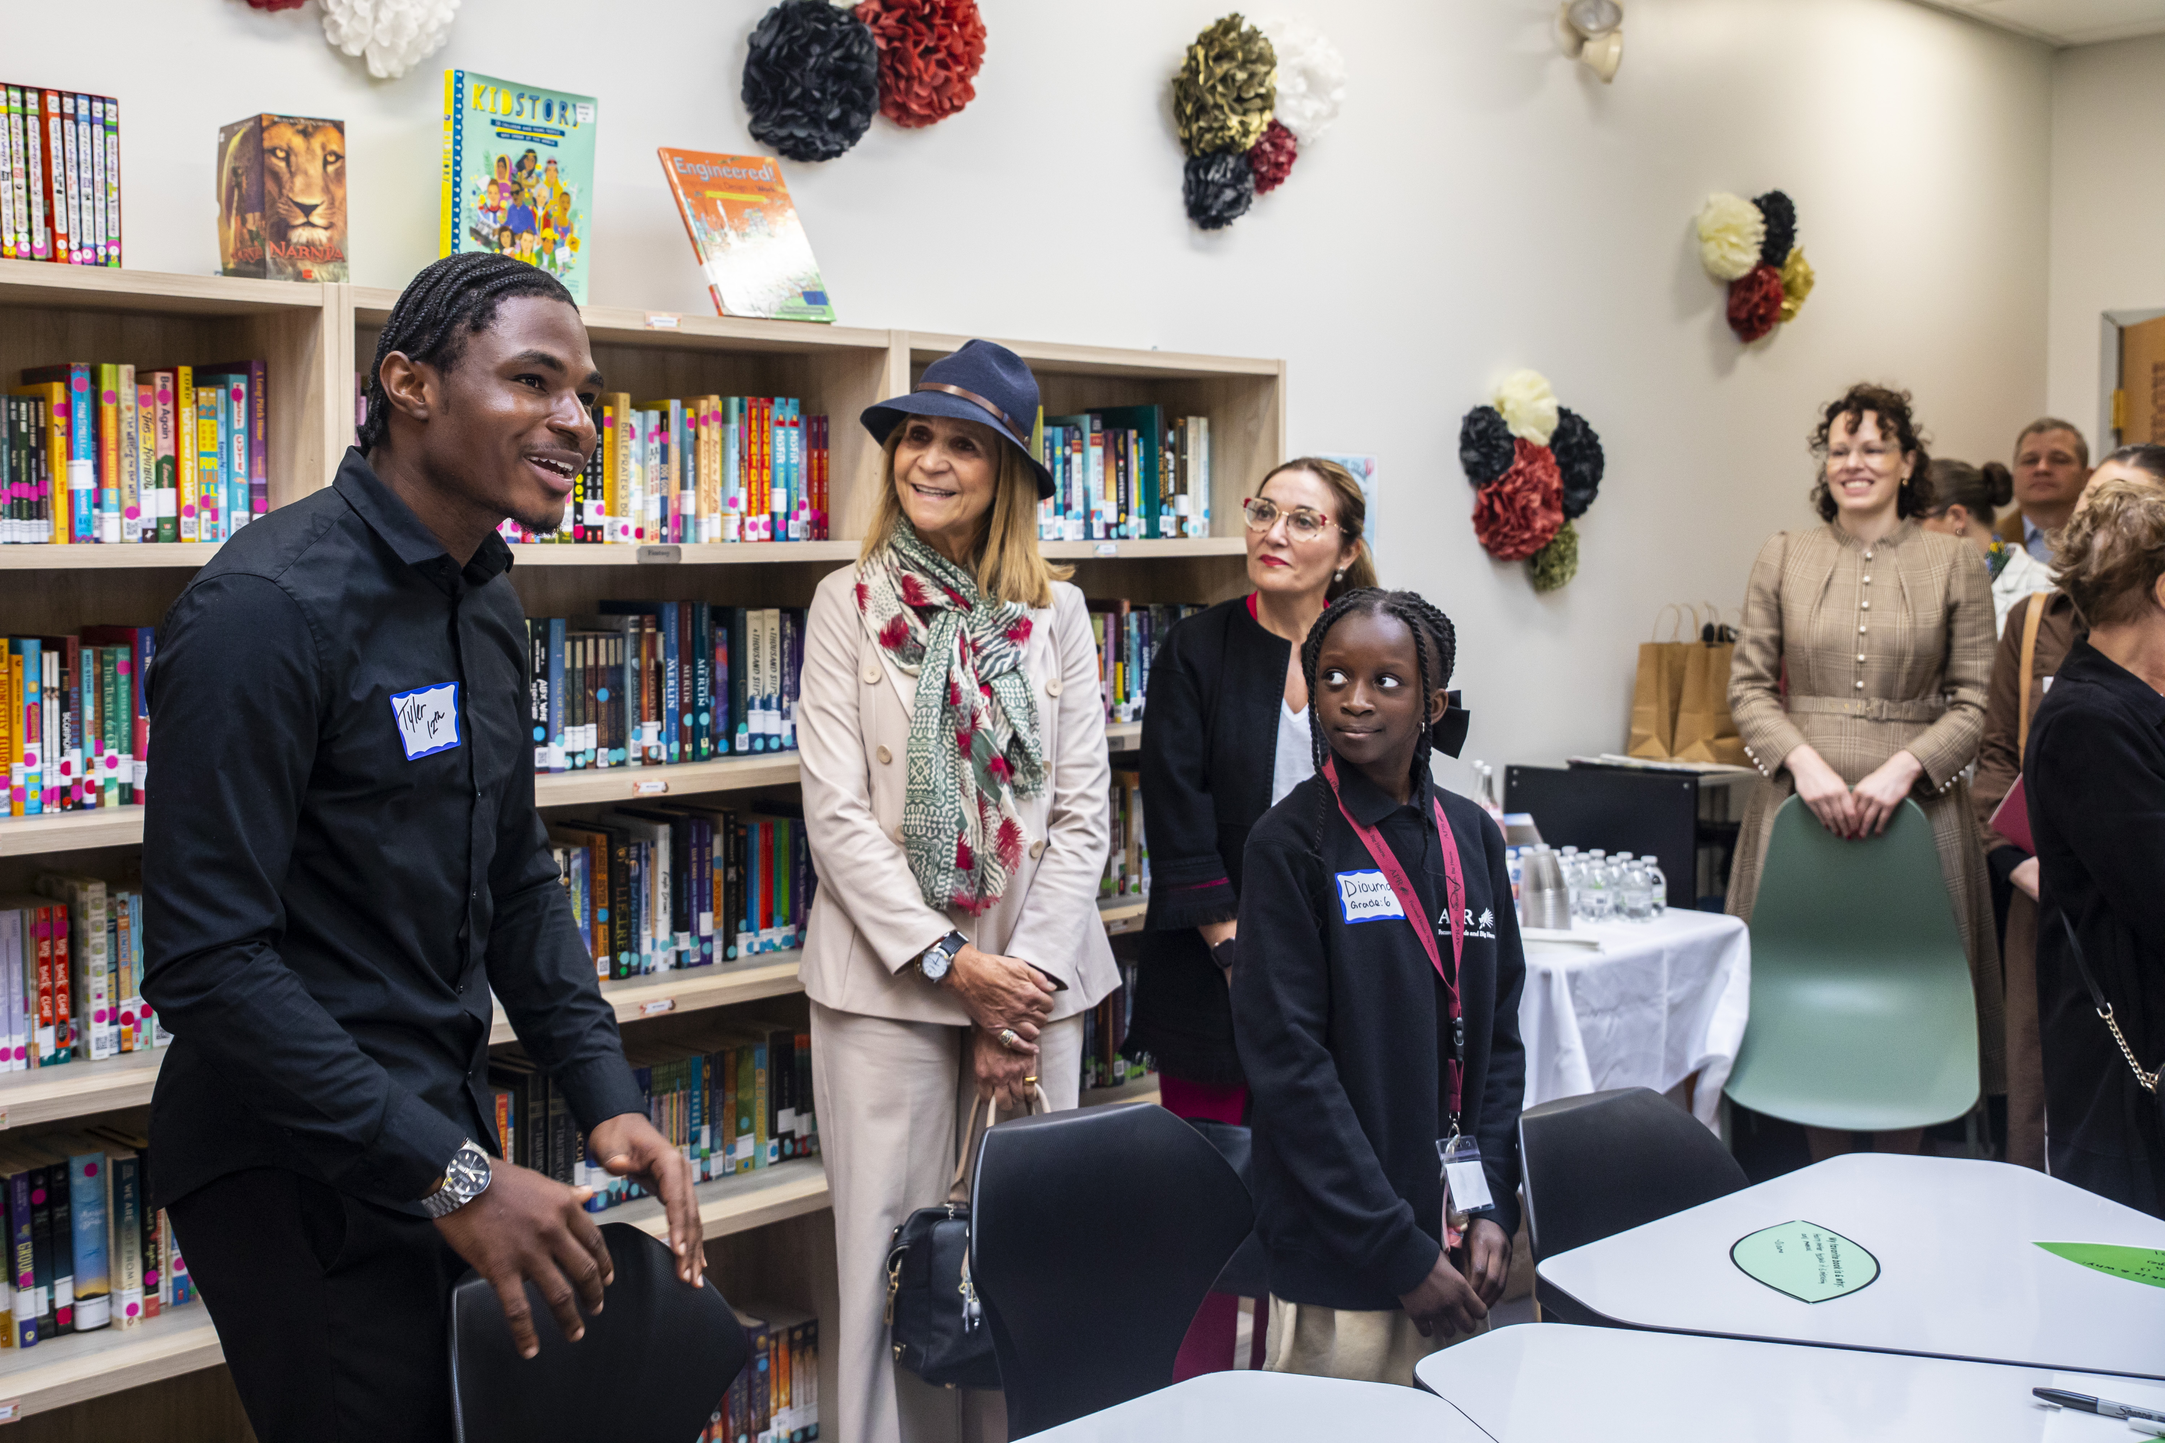

Fundación Mapfre in the United States
Social Action
Academy of the Pacific Rim (APR) is a charter public school whose mission is to empower students of all racial and ethnic backgrounds to achieve their full intellectual and social potential.
Transformational Leadership Program: Fundación Mapfre has partnered with APR to foster their transformational instructional leadership and strengthen teaching and learning at APR to ensure students have access to rigorous curricular experiences that will lead to lives of opportunity and global impact.

Slide 16
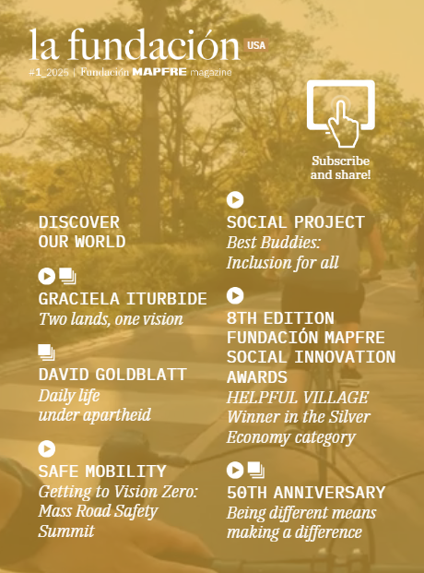
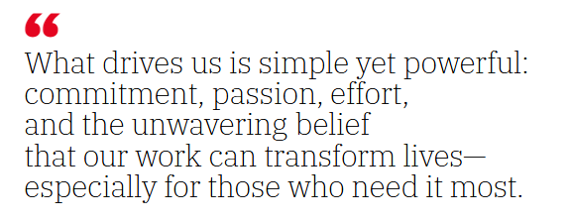
Fundación Mapfre in the United States
La Fundación Magazine USA
- Jaime Tamayo
In 2025, Fundación Mapfre launched the La Fundación USA, a new interactive magazine that showcases the incredible work of the Fundación Mapfre across the United States.
From road safety and community programs to arts and culture, explore how we care for our customers and communities through education, safety and compassion.
2026 will produce two editions of the magazine.
Read La Fundación USA

Slide 17
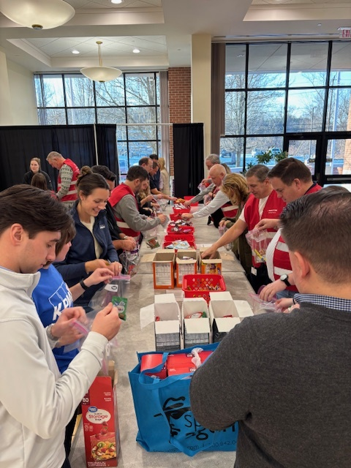

Fundación Mapfre in the United States
2026 Corporate Volunteer Program
Key Dates
April 20 - 24: We Care About Our Communities Week
June 1 - 5: Mapfre Culture Week
June 19: United Way Day of Caring
August 1 - 2: Pan-Mass Challenge Weekend
October 3: Global Volunteer Day
November 14: Thanksgiving Family Give Back Event

